Slide 1


Exploring Bitcoin And Cryptocurrency Market

Slide 2


TEAMS MEMBERS
NAME | ROLL NO
VIJAY VARDHAN M | 20211IST0019
SUDIKSHA.N | 20211IST0016
D P RAKSHITHA | 20211IST0007

Slide 3
INTRODUCTION:
The cryptocurrency market, particularly Bitcoin, is a complex and dynamic system that presents both opportunities and risks for investors.
In this report, we present an analysis of Bitcoin price data using Python programming language.
The analysis includes predicting future prices, assessing volatility, and evaluating market sentiment using various machine learning models and techniques.

Slide 4
DATA USED:
The data used in this project is gathered from Wikipedia for sentiment analysis, and Yahoo finance for Bitcoin prices over the years.

Slide 5
METHODOLOGY USED
1.Random Forest Classifier: is an ensemble learning method primarily used for classification tasks. It builds multiple decision trees during training and merges them to get a more accurate and stable prediction.
How It Works:
Decision Trees
Bootstrap Aggregating (Bagging):
Random Feature Selection
Majority Voting
Advantages:
Robustness
Accuracy

Slide 6
METHODOLOGY USED
XGBClassifier: is part of the XGBoost library, which stands for Extreme Gradient Boosting. It is a powerful machine learning algorithm used for supervised learning tasks, including classification and regression.
How It Works:
Gradient Boosting Framework:
Boosting
Regularization
Efficiency
Advantages:
Performance
Flexibility
Handling Complexity

Slide 7
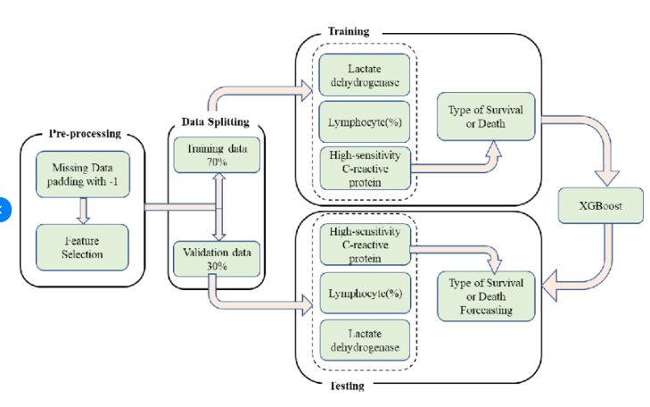
FLOWCHART OF METHODOLOGY
XGB Classifier

Slide 8
LIMITATIONS:
Data Quality and Feature Selection
Non-Stationarity
Lack of Causality
Overfitting
Model interpretability

Slide 9
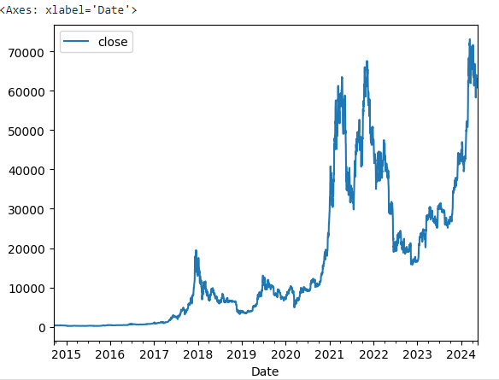
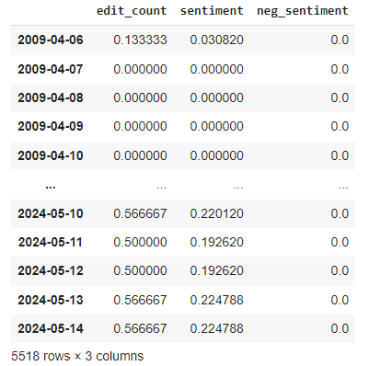
RESULT

Slide 10
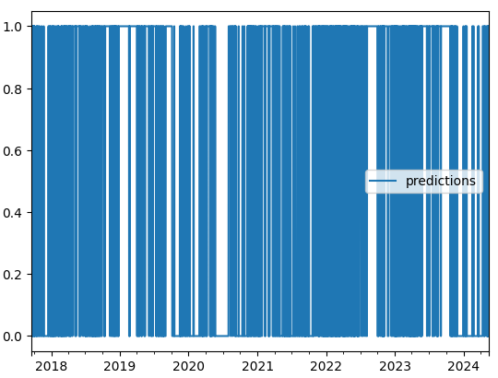
RESULT

Slide 11

CONCLUSION
Using data analysis and machine learning techniques for Bitcoin price prediction can provide valuable insights, but it's essential to acknowledge the limitations. While models like Decision Trees (such as RandomForestClassifier) and Gradient Boosting (like XGBClassifier) can offer predictive power, factors like data quality, market dynamics, and model interpretability significantly impact their effectiveness. Therefore, while these approaches can be informative, they should be used cautiously, supplemented with domain expertise, and considered alongside other analytical methods for a comprehensive understanding of Bitcoin price movements.

Slide 12

THANK YOU !!!

